Slide 1
Quick admin follow-up
HW 1 was due last night at midnight
Late deadline is midnight Sept 13
HW0 is due at midnight, Sept. 14
If you’re still on the waitlist and still want in
Submit HW0 and then send me a Piazza message ASAP
TA office hours will be announced

Slide 2
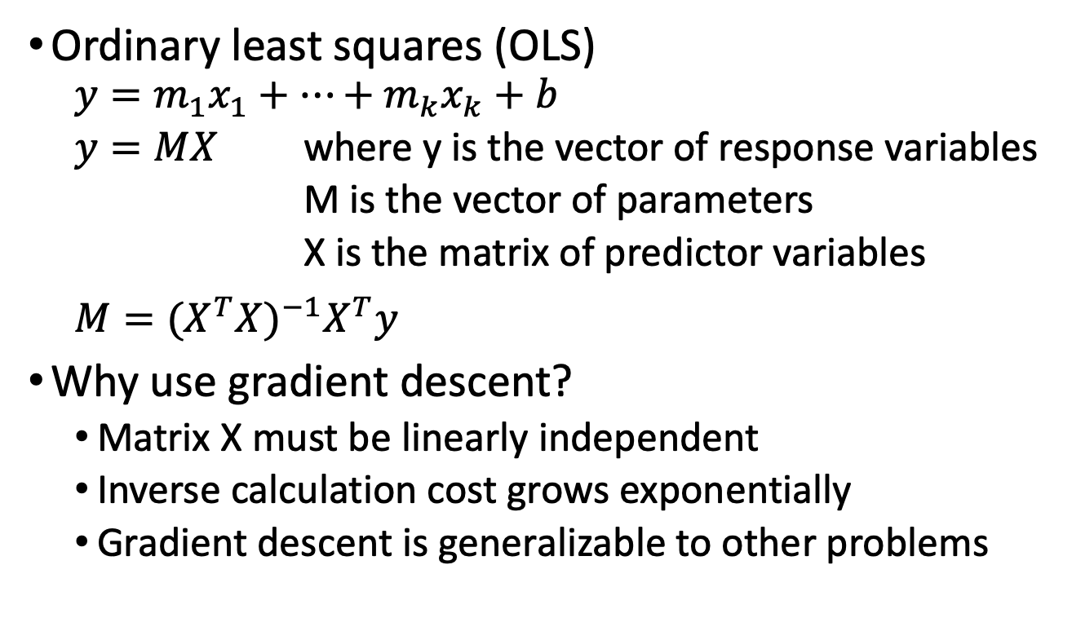
Closed form solution for linear regression
Ordinary least squares (OLS)
$$y=m_{1}x_{1}+…+m_{k}x_{k}+b$$
$y=MX$ where y is the vector of response variables
M is the vector of parameters
X is the matrix of predictor variables
$$M={(X^{T}X)}^{−1}X^{T}y$$
Why use gradient descent?
Matrix X must be linearly independent
Inverse calculation cost grows exponentially
Gradient descent is generalizable to other problems

Slide 3
CSE514 – Datamining Fall 2022 Classification
Cynthia Ma
Department of Computer Science
Washington University in St. Louis
czma@wustl.edu

Slide 4
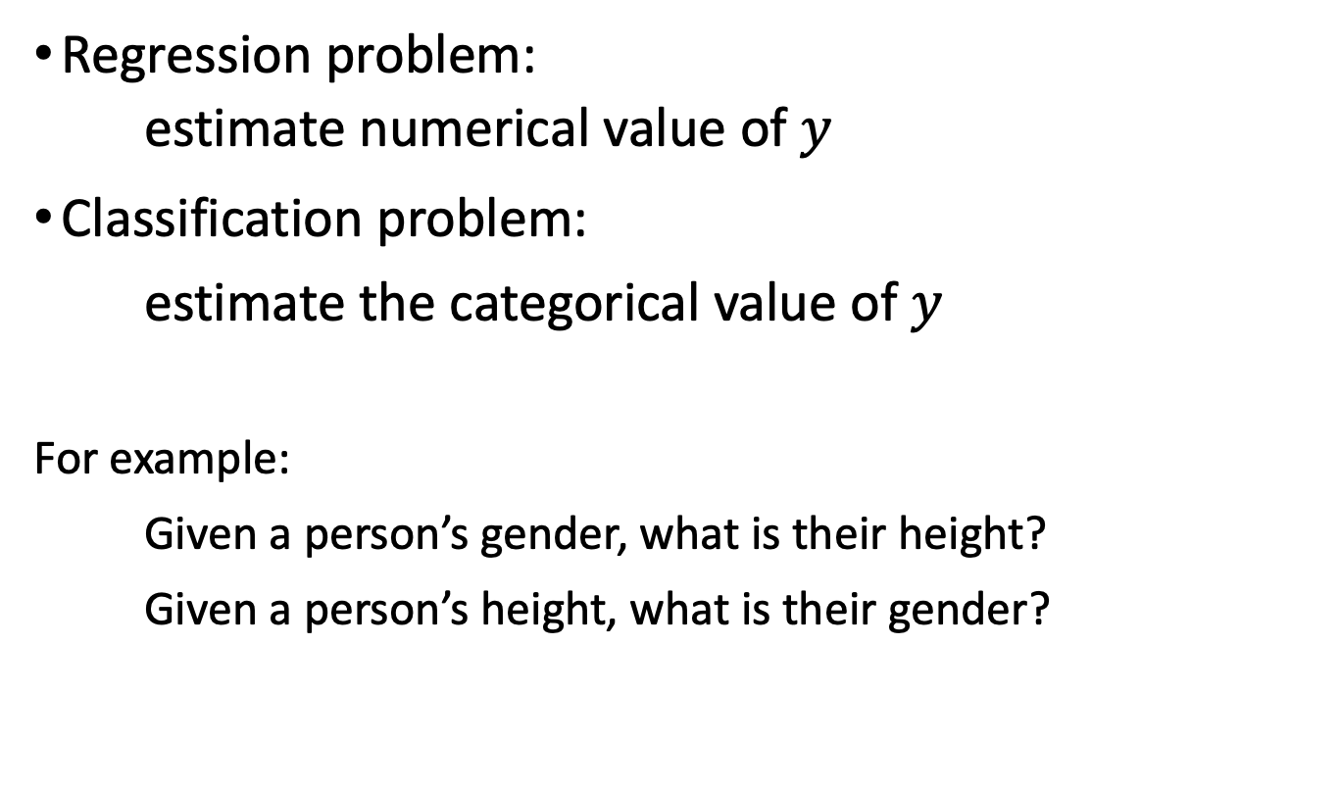
Regression vs. Classification
Regression problem:
estimate numerical value of $y$
Classification problem:
estimate the categorical value of $y$
For example:
Given a person’s gender, what is their height?
Given a person’s height, what is their gender?

Slide 5
Classification w/regression model
Define thresholds to bin the outcomes of regression

Slide 6
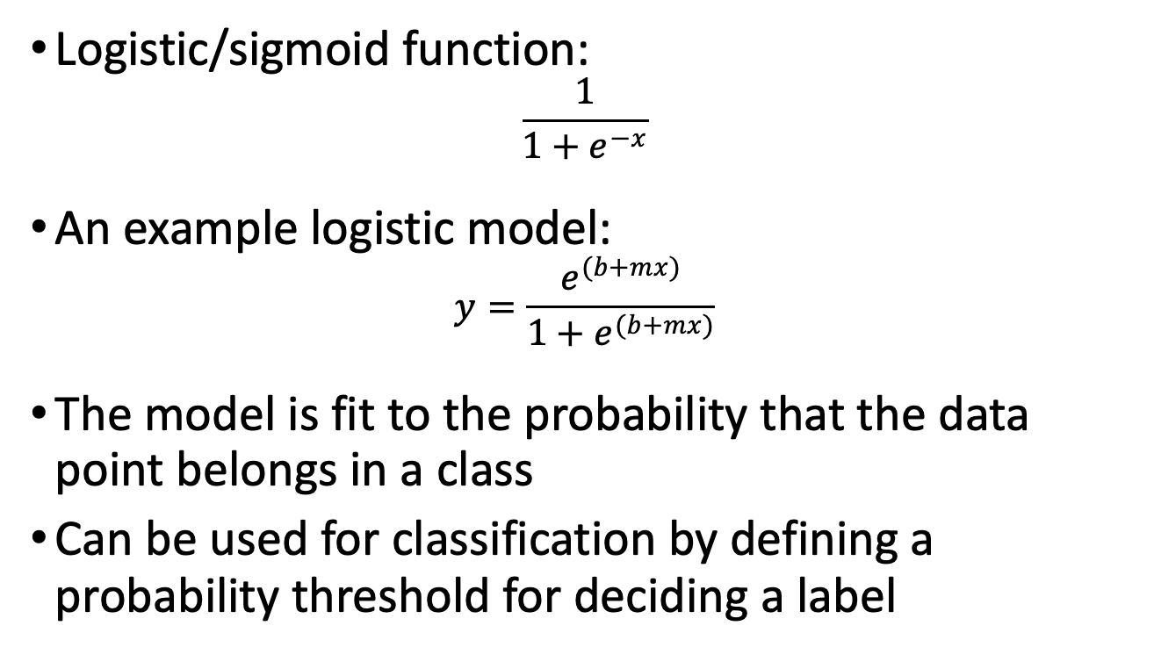
Logistic Regression
Logistic/sigmoid function:
$$\frac{1}{1+e^{−x}}$$
An example logistic model:
$$y=\frac{e^{(b+mx)}}{1+e^{(b+mx)}}$$
The model is fit to the probability that the data point belongs in a class
Can be used for classification by defining a probability threshold for deciding a label

Slide 7
Nearest Neighbors Classification
Very commonly used classifier!
Based on the intuition of “guilty by association”
Find the data point most similar that has a label
Use that label
k-NN: an extension that considers more than just one neighbor

Slide 8
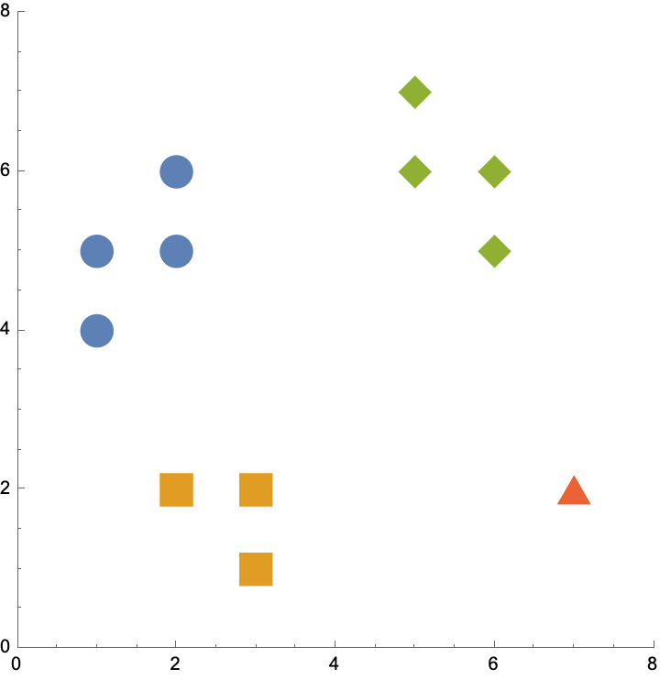
What is “most similar”?
Manhattan distance
Euclidean distance
Hamming distance
used for categorical data
distance is 0 if the labels are the same
distance is 1 if the labels are different
Dot Product

Slide 9
What is the value of k?
As k increases, more neighbors get a vote in the prediction
More votes = more stability in predictions
More votes = higher likelihood of including votes from dis-similar neighbors
Can use cross-validation to search for the best k

Slide 10
Cross-validation
Goals:
Avoid overfitting by testing for poor performance on non-training data
Pick hyperparameter values based on testing performance
Given a large dataset, split it up to create training and testing data sets
k-fold cross validation:
Divide the data into k fair subsets
Train the model without one of the subsets
Test the model’s performance on the holdout data
Repeat from step 2 with remaining subsets

Slide 11
Data set terminology
Training set: data that the model is given with both predictor and response values
Testing/validation set: data that the model is only given predictor values for
Testing – will eventually contribute to the model, such as hyperparameter tuning
Validation – kept independent from the model, used to either report performance, or to pick between models

Slide 12
Cross validation application
Gradient descent
Search for the optimal stopping threshold
Regularization
Search for the optimal lambda penalty weight
k-nearest neighbors classification
Search for the optimal k

Slide 13
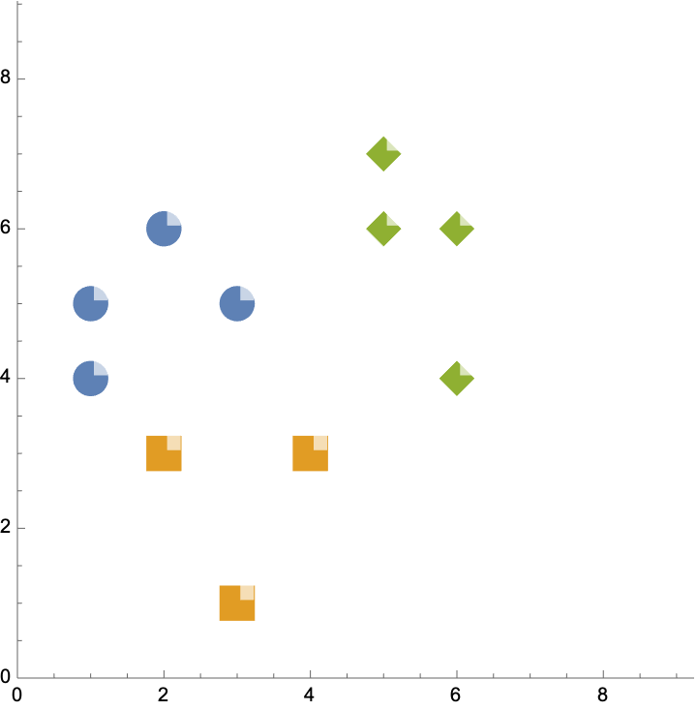
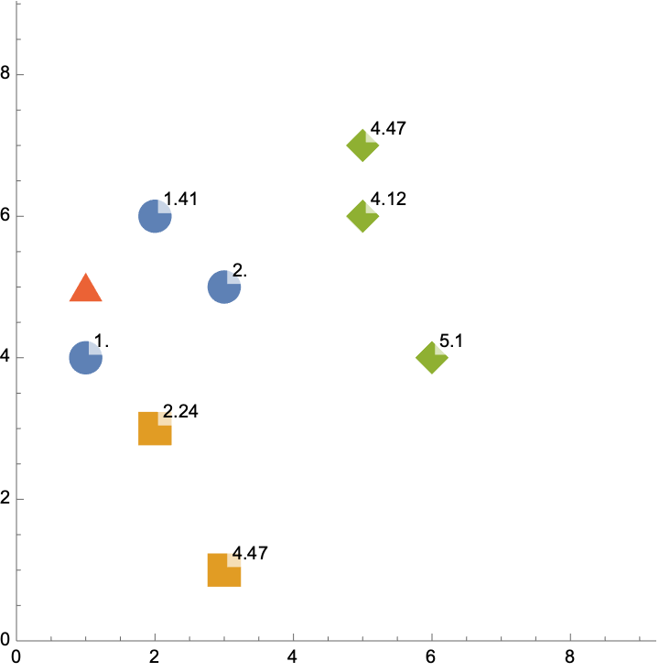
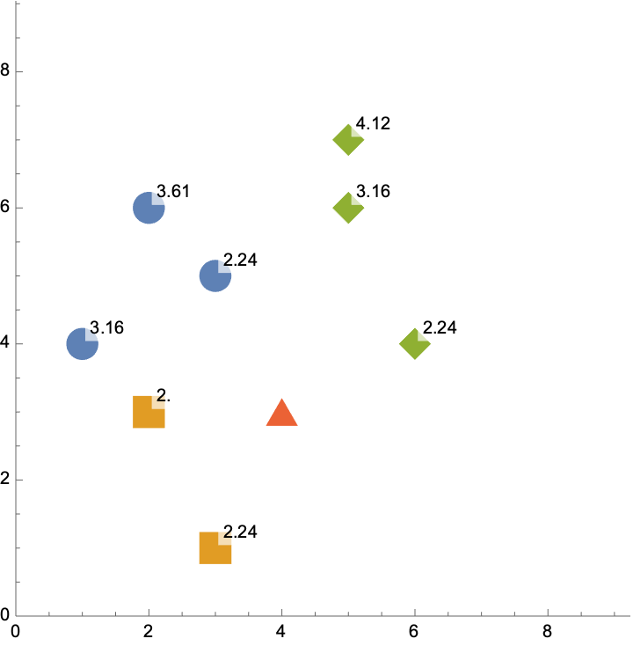
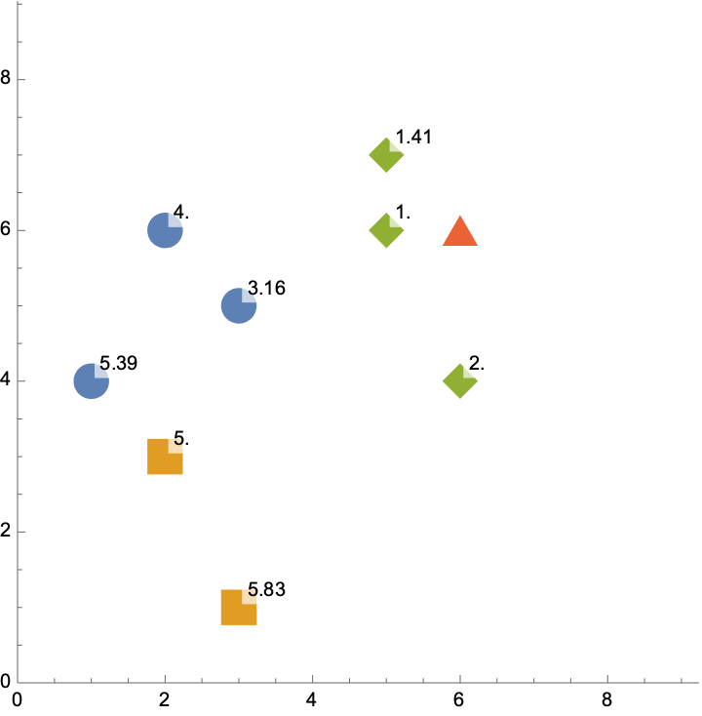
CV example
Train a kNN model
Euclidean distances
3-fold CV
First fold
Second fold
Third fold

Slide 14
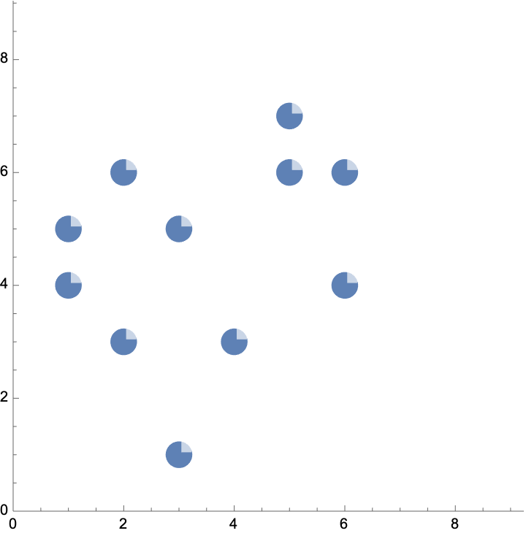
Regression w/kNN classifier
Use the average values of its k nearest neighbors
Imagine the x-axis is the feature, and the y-axis the response
Predict for k=1
Predict for k=5

Slide 15
Review
Regression vs Classification problems
Logistic regression
kNN classification
Cross validation for hyper-parameter selection
kNN regression

Slide 16
Homework
Sign up on Piazza
Submit HW 0: Course Questionnaire
Submit HW 1: Data Processing
Programming assignment 1: Regression
Office hours Friday, 2-4pm on Zoom and Urbauer 226

